Slide 1
Data Models
Data Models

Slide 2



Outline
1 Data Models
2
Attributes and Constraints
3
Extending E-R Features
4
ER Diagram to Relational Model
Data Models

Slide 3
Data Models
Data Models
A Collection of concepts that can be used to describe the structure of a database (datatypes, relationships, and constraints that the data should adhere to)
High Level Data Models: Entity-Relationship (E-R) Model, Unified Modeling Language (UML)
Representational Data Models: Network, Hierarchical, Relational [Edgar F. Codd (1970)]
Physical Data Models: Data structures
Data Models

Slide 4
ER Model
Data Models
E-R Model: The entity-relationship (E-R) data model is useful in mapping the meanings and interactions of real-world enterprises on to a conceptual schema.
Entity: An entity is a ‘thing’ or ‘object’ in the real world that is distinguishable from all other objects.
An entity is represented by a set of attributes.
Entity Set: An entity set is a set of entities of the same type that share the same properties, or attributes.
Relationship: A relationship is an association among several entities.
Degree of a relationship: Number of entities participating in the relationship. If the association is among n entities, we call it n-ary relationship.
If the association is among two entities, we call it binary relationship.
Data Models

Slide 5
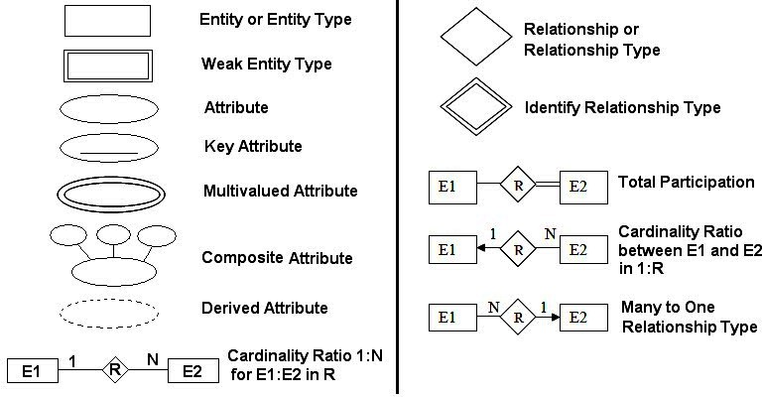
Data Models
Data Modelling Using ER model
Data Models

Slide 6
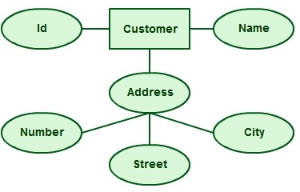
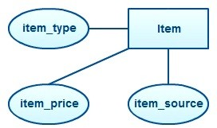
Data Models
Entity Sets / Entity Types
Data Models

Slide 7
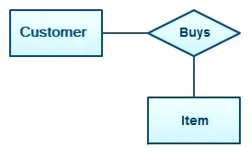
Data Models
Relationship Sets
Data Models

Slide 8
Attributes
Attributes and Constraints
Attribute:
For each attribute, there is a set of permitted values, called the domain, or value set, of that attribute
Types of Attributes:
Simple and Composite Attribute
Single-valued and Multi-valued Attribute Derived Attribute
Complex (Multi-valued as well as Composite)
Data Models

Slide 9
Structural Constraints
Attributes and Constraints
Cardinality Constraints / Maximum Participation / Cardinality ratio:
Maximum number an entity in entity set E is allowed to participate in a relationship set R
One-to-One, One-to-many OR Many-to-one, Many-to-many
Modality / Participation Constraints / Minimum Participation / Existence Dependency Constraint:
can be Zero for Optional, One or more for Mandatory
An entity set E participates in total with a relationship set R if every entity in E
participates in at least one relationship in R.
An entity set E participates in partial with a relationship set R if some entity in E
participates in at least one relationship in R.
Data Models

Slide 10
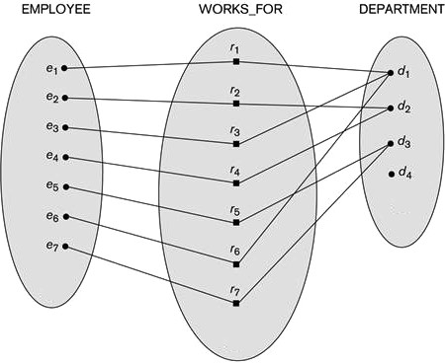
Structural Constraints
Attributes and Constraints
Organizational Rule:
Each employee works for a particular department
Many employees can work in a single department
There can be departments where no employees work
Participation of EMPLOYEE in WORKS FOR: Max : 1 , Min : 1
Participation of DEPARTMENT in WORKS FOR: Max : N , Min : 0
Data Models

Slide 11

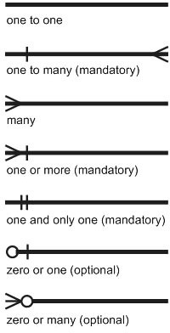

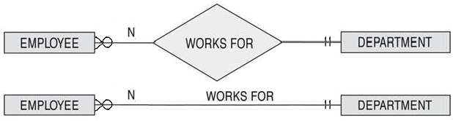
Structural Constraints
Attributes and Constraints
Cardinality Ratio representation: cardinality of two entities written in distance from them (looks like swapped)!
Min-Max Representation: Provides more information! Possible to draw for n-ary relationship.
Data Models

Slide 12
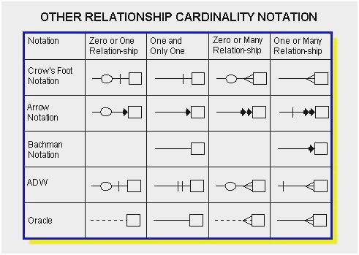
Attributes and Constraints
Structural Constraints
We won’t learn these!
Data Models

Slide 13
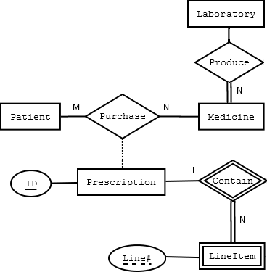
Structural Constraints
Attributes and Constraints
Medicine participates totally in the Produce relationship, meaning that a medicine can’t exist unless Produced by a laboratory. In contrast, a laboratory can exist without producing any medicine - Laboratory participates partially in the Produce relationsip.
a Patient can Purchase Medicine with or without a Prescription. A Purchase can’t exist without a Patient and Medicine, but a Prescription is optional in Purchase relationship.
a Prescription contains LineItems which are identified by the Prescription’s key (ID)and a line number (Line#) together, and not by Line# only. In other words, the LineItems will have a composite key (ID, Line#).
Data Models

Slide 14
Types of Entity Sets
Attributes and Constraints
Strong Entity Set: An entity set that has a primary key is termed a strong entity set.
Weak Entity Set: An entity set that does not have sufficient attribute to form a primary key is termed a weak entity set.
Every weak entity must be associated with an identifying entity, i.e., said to be existence dependent on the identifying entity set.
The relationship associating the weak entity set with the identifying entity set is called the
identifying relationship.
Data Models

Slide 15
Entity Sets
Attributes and Constraints
Q. Which one of the following is used to represent the supporting many-one relationships of a weak entity set in an entity-relationship diagram?
Diamonds with double/bold border
Rectangles with double/bold border
Ovals with double/bold border
Ovals that contain underlined identifiers [GATE 2020]
ANSWER: (a)
Data Models

Slide 16
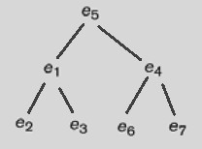
Attributes and Constraints
Recursive Relationship
Data Models

Slide 17
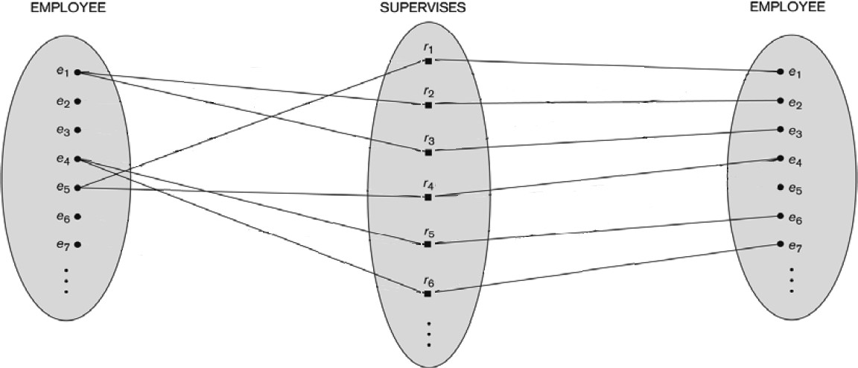
Attributes and Constraints
Recursive Relationship
Data Models

Slide 18
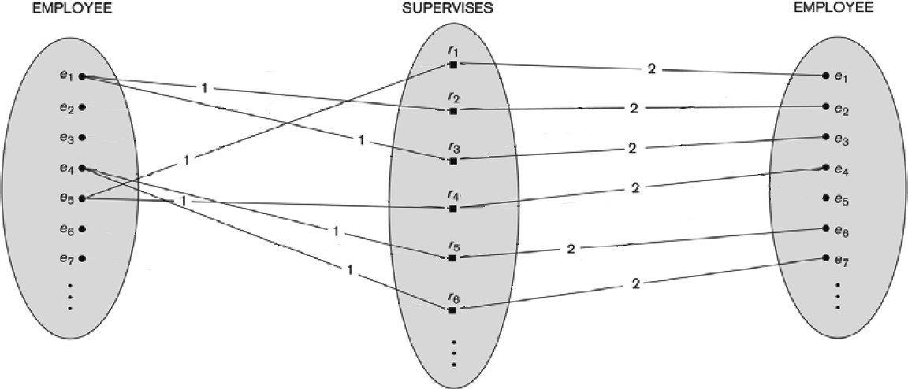
Attributes and Constraints
Recursive Relationship
Data Models

Slide 19
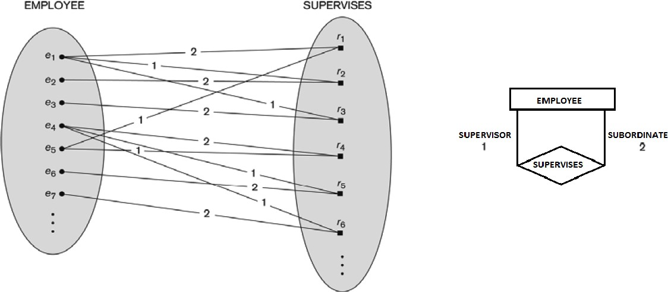
Attributes and Constraints
Recursive Relationship
Data Models

Slide 20
Extending E-R Features
Extending E-R Features
Specialization is the process of classifying a class of objects into more specialized subclasses.
Generalization is the process of generalizing several classes into a higher-level abstract class that includes the objects in all these classes.
Specialization is conceptual refinement, whereas generalization is conceptual synthesis.
Aggregation is an abstraction concept for building composite objects from their component objects.
Association is an abstraction concept used to associate objects from several independent classes.
Data Models

Slide 21
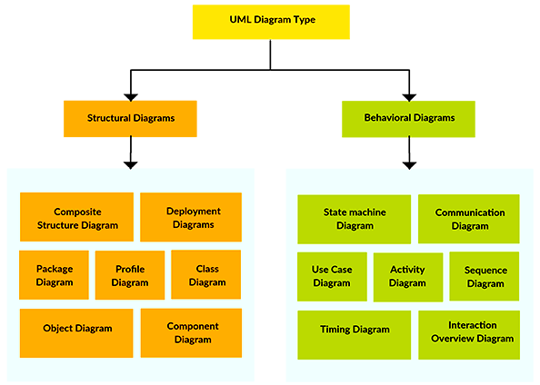
Extending E-R Features
Types of UML Diagram
Data Models

Slide 22
ER Diagram to Relational Model
ER Diagram to Relational Model
ER Model
Relational Model
Entity Type
Entity Relation
1:1 or 1:N relationship type
foreign key (or relation)
M:N relationship type
a relation with 2 foreign keys
n-ary relationship type
a relation with n foreign keys
simple attribute
attribute in relation
composite attribute
set of attributes in relation
multivalued attribute
relation and foreign key
value set
domain
key attributes
keys / candidate keys / primary keys
Data Models

Slide 23
Properties of Relational Model
ER Diagram to Relational Model
There are no duplicate tuples. (Does not match your experience in your SQL lab!! Why??) Tuples are unordered.
Attributes are unordered.
All attribute values are atomic.
Data Models

Slide 24
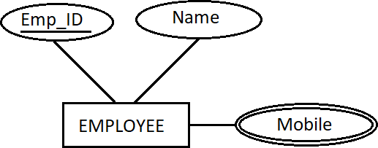
ER Diagram to Relational Model with example
ER Diagram to Relational Model
Problem with multi-valued attribute!
EMPLOYEE
Emp ID | Name | Mobile
123 | De Yu | 2032
123 | De Yu | 2033
134 | Min Jiang | 2066
134 | Min Jiang | 2067
134 | Min Jiang | 2068
135 | Bin Zhu | NULL
Data Models

Slide 25

ER Diagram to Relational Model with example
ER Diagram to Relational Model
Emp ID | Name | Emp ID | Mobile
Usage of foreign key solves the problem!
Emp ID | Name
123 | De Yu
134 | Min Jiang
135 | Bin Zhu
Emp ID | Mobile
123 | 2032
123 | 2033
134 | 2066
134 | 2067
134 | 2068
136 | 2099
EMPLOYEE
Emp ID | Name | Mobile
123 | De Yu | 2032
123 | De Yu | 2033
134 | Min Jiang | 2066
134 | Min Jiang | 2067
134 | Min Jiang | 2068
135 | Bin Zhu | NULL
But number of table increases!
Data Models

Slide 26
ER Diagram to Relational Model with example
ER Diagram to Relational Model
Emp ID | Name | Mobile 1 | Mobile 2
123 | De Yu | 2032 | 2033
134 | Min Jiang | 2066 | 2067
135 | Bin Zhu | NULL | NULL
An organization may not care for a third mobile number.
We loose one phone number (2068) of Min Jiang,
but number of table remains same!
This might be a suboptimal solution, but not an equivalent one.
EMPLOYEE
Emp ID | Name | Mobile
123 | De Yu | 2032
123 | De Yu | 2033
134 | Min Jiang | 2066
134 | Min Jiang | 2067
134 | Min Jiang | 2068
135 | Bin Zhu | NULL
Data Models

Slide 27
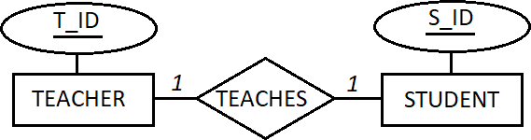
ER Diagram to Relational Model with example
ER Diagram to Relational Model
TEACHER
STUDENT
T ID
T 1
T 2
T 3
T 4
T 5
T 6
T 7
TEACHES
S ID
S 1
S 2
S 3
S 4
S 5
S 6
S 7
S 8
T ID | S ID
T 1 | S 7
T 3 | S 5
T 6 | S 1
T 7 | S 1
T 4 | NULL
NULL | S 2
Can these three tables be reduced?
T ID
T ID S ID
S ID
Data Models

Slide 28
ER Diagram to Relational Model with example
ER Diagram to Relational Model
TEACHER-TEACHES
STUDENT
T ID | S ID
T 1 | S 7
T 2 | NULL
T 3 | S 5
T 4 | NULL
T 5 | NULL
T 6 | S 1
T 7 | NULL
S ID
S 1
S 2
S 3
S 4
S 5
S 6
S 7
S 8
TEACHER
STUDENT
T ID
T 1
T 2
T 3
T 4
T 5
T 6
T 7
TEACHES
S ID
S 1
S 2
S 3
S 4
S 5
S 6
S 7
S 8
T ID | S ID
T 1 | S 7
T 3 | S 5
T 6 | S 1
T 7 | S 1
T 4 | NULL
NULL | S 2
Option 1: Pushing the information of the relationship to the TEACHER side
T ID
S ID
S ID
Usage of foreign key solves the problem!
T ID
T ID S ID
S ID
Data Models

Slide 29
ER Diagram to Relational Model with example
ER Diagram to Relational Model
TEACHER
STUDENT-TAUGHTBY
T ID
T 1
T 2
T 3
T 4
T 5
T 6
T 7
S ID | T ID
S 1 | T 6
S 2 | NULL
S 3 | NULL
S 4 | NULL
S 5 | T 3
S 6 | NULL
S 7 | T 1
S 8 | NULL
TEACHER
STUDENT
T ID
T 1
T 2
T 3
T 4
T 5
T 6
T 7
TEACHES
S ID
S 1
S 2
S 3
S 4
S 5
S 6
S 7
S 8
T ID | S ID
T 1 | S 7
T 3 | S 5
T 6 | S 1
T 7 | S 1
T 4 | NULL
NULL | S 2
Option 2: Pushing the information of the relationship to the STUDENT side
T ID
S ID
T ID
Usage of foreign key solves the problem!
T ID
T ID S ID
S ID
Data Models

Slide 30
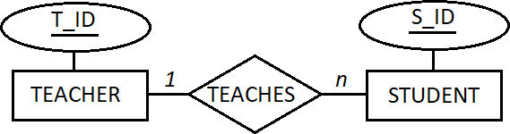
ER Diagram to Relational Model with example
ER Diagram to Relational Model
TEACHER
TEACHES
STUDENT
T ID
T 1
T 2
T 3
T 4
T 5
T 6
T 7
T ID | S ID
T 1 | S 7
T 3 | S 5
T 6 | S 1
T 1 | S 3
T 7 | S 1
T 4 | NULL
NULL | S 2
S ID
S 1
S 2
S 3
S 4
S 5
S 6
S 7
S 8
Can these three tables be reduced?
T ID
T ID S ID
S ID
Data Models

Slide 31
ER Diagram to Relational Model with example
ER Diagram to Relational Model
TEACHER
STUDENT-TAUGHTBY
T ID
T 1
T 2
T 3
T 4
T 5
T 6
T 7
S ID | T ID
S 1 | T 6
S 2 | NULL
S 3 | T 1
S 4 | NULL
S 5 | T 3
S 6 | NULL
S 7 | T 1
S 8 | NULL
TEACHER
TEACHES
STUDENT
T ID
T 1
T 2
T 3
T 4
T 5
T 6
T 7
T ID | S ID
T 1 | S 7
T 3 | S 5
T 6 | S 1
T 1 | S 3
T 7 | S 1
T 4 | NULL
NULL | S 2
S ID
S 1
S 2
S 3
S 4
S 5
S 6
S 7
S 8
Only option: Pushing the information of the relationship to the STUDENT side
T ID
S ID
T ID
Usage of foreign key solves the problem!
T ID
T ID S ID
S ID
Data Models

Slide 32
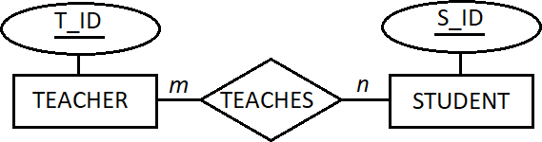
ER Diagram to Relational Model with example
ER Diagram to Relational Model
TEACHER
STUDENT
T ID
T 1
T 2
T 3
T 4
T 5
T 6
T 7
TEACHES
S ID
S 1
S 2
S 3
S 4
S 5
S 6
S 7
S 8
T ID | S ID
T 1 | S 7
T 3 | S 5
T 6 | S 1
T 1 | S 3
T 7 | S 1
T 6 | S 5
Can these three tables be reduced?
T ID
T ID S ID
S ID
Data Models

Slide 33
ER Diagram to Relational Model with example
ER Diagram to Relational Model
TEACHER
STUDENT
T ID
T 1
T 2
T 3
T 4
T 5
T 6
T 7
TEACHES
S ID
S 1
S 2
S 3
S 4
S 5
S 6
S 7
S 8
T ID | S ID
T 1 | S 7
T 3 | S 5
T 6 | S 1
T 1 | S 3
T 7 | S 1
T 6 | S 5
No option to reduce these three tables to a lesser number.
Two foreign keys are used.
T ID
T ID S ID
S ID
Data Models

Slide 34
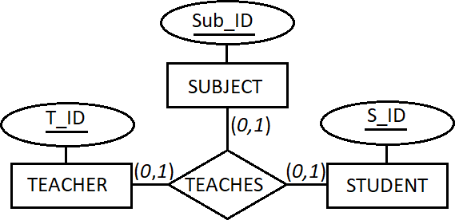
ER Diagram to Relational Model with example
ER Diagram to Relational Model
TEACHER
STUDENT
T ID
T 1
T 2
T 3
T 4
T 5
T 6
T 7
S ID
SUBJECT
S 1
Sub ID
CS 1
CS 2
CS 3
CS 4
CS 5
TEACHES
S 2
T ID | S ID | Sub ID
T 1 | S 7 | CS1
T 3 | S 5 | CS2
T 6 | S 1 | CS3
S 3
S 4
S 5
S 6
S 7
S 8
T ID
S ID
Sub ID
T ID | S ID | Sub ID
To reduce these four tables to a lesser number, push the relationship to any entity.
Two foreign keys are used.
Data Models

Slide 35
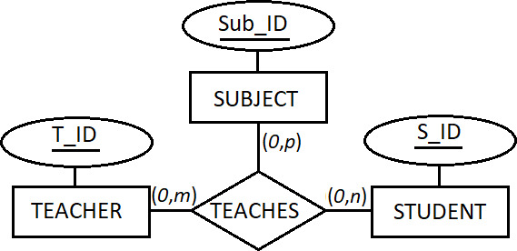
ER Diagram to Relational Model with example
ER Diagram to Relational Model
TEACHER
STUDENT
T ID
T 1
T 2
T 3
T 4
T 5
T 6
T 7
S ID
SUBJECT
TEACHES
S 1
Sub ID
CS 1
CS 2
CS 3
CS 4
CS 5
T ID | S ID | Sub ID
T 1 | S 7 | CS1
T 3 | S 5 | CS2
T 6 | S 1 | CS3
T 1 | S 6 | CS1
T 4 | S 7 | CS1
T 3 | S 1 | CS4
S 2
S 3
S 4
S 5
S 6
S 7
S 8
T ID
S ID
Sub ID
T ID | S ID | Sub ID
Cannot reduce these four tables to a lesser number.
Three foreign keys are used.
Data Models

Slide 36
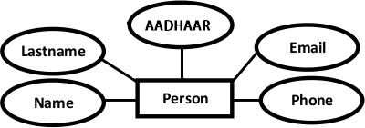
ER Diagram to Relational Model
ER Diagram to Relational Model
Verify the type of attributes and select only simple ones
Identify multivalued and complex
attributes
Data Models

Slide 37
ER Diagram to Relational Model
ER Diagram to Relational Model
Q. Given the basic ER and relational models, which of the following is INCORRECT?
An attribute of an entity can have more than one value
An attribute of an entity can be composite
In a row of a relational table, an attribute can have more than one value
In a row of a relational table, an attribute can have exactly one value or a NULL value [GATE 2012]
Data Models

Slide 38
ER Diagram to Relational Model
ER Diagram to Relational Model
Q. Given the basic ER and relational models, which of the following is INCORRECT?
An attribute of an entity can have more than one value
An attribute of an entity can be composite
In a row of a relational table, an attribute can have more than one value
In a row of a relational table, an attribute can have exactly one value or a NULL value [GATE 2012]
ANSWER (c)
Data Models

Slide 39
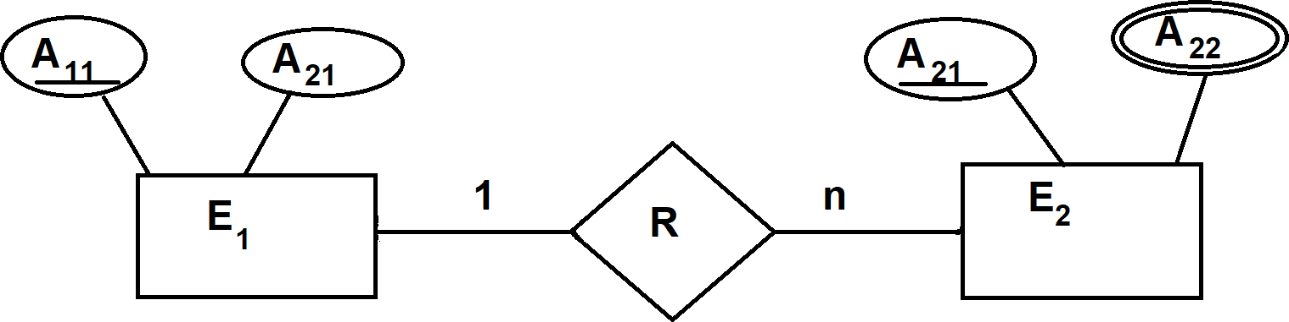
ER Diagram to Relational Model
ER Diagram to Relational Model
Q1. Maximum how many relations (tables) would be required when this ER diagram will be converted to relational model?
Q2. Minimum how many relations
(tables) would be required when this ER diagram will be converted to relational model?
[GATE 2004]
Data Models

Slide 40
ER Diagram to Relational Model
ER Diagram to Relational Model
Q1. Maximum how many relations (tables) would be required when this ER diagram will be converted to relational model?
Q2. Minimum how many relations
(tables) would be required when this ER diagram will be converted to relational model?
[GATE 2004]
ANSWER to Q1: 3 ANSWER to Q2: 2
Data Models

Slide 41
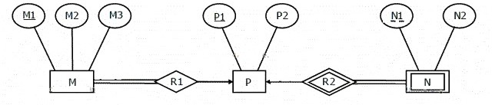
ER Diagram to Relational Model
ER Diagram to Relational Model
Q1. Minimum how many relations (tables) would be required when this ER diagram will be converted to relational model?
Q2. Which of the following is a correct attribute set for one of the tables for the correct answer
to the above question?
(a) M1,M2,M3,P1 (b) M1, P1, N1, N2 (c) M1, P1, N1 (d) M1, P1
[GATE 2008]
Data Models

Slide 42
ER Diagram to Relational Model
ER Diagram to Relational Model
Q1. Minimum how many relations (tables) would be required when this ER diagram will be converted to relational model?
Q2. Which of the following is a correct attribute set for one of the tables for the correct answer
to the above question?
(a) M1,M2,M3,P1 (b) M1, P1, N1, N2
(c) M1, P1, N1 [GATE 2008] ANSWER Q1. 2
(d) M1, P1
ANSWER Q2. (a) M1,M2,M3,P1
Data Models

Slide 43
ER Diagram to Relational Model
ER Diagram to Relational Model
Q. E1 and E2 are two entities (with only simple attributes) having R1 and R2 as two relationships between them.
R1 is a one-to-many and R2 is a many-to-many relationship. R1 and R2 do not have any
attribute of their own.
What is the minimum number of tables required to convert this ER model to relational model? [GATE 2005]
Data Models

Slide 44
ER Diagram to Relational Model
ER Diagram to Relational Model
Q. E1 and E2 are two entities (with only simple attributes) having R1 and R2 as two relationships between them.
R1 is a one-to-many and R2 is a many-to-many relationship. R1 and R2 do not have any
attribute of their own.
What is the minimum number of tables required to convert this ER model to relational model? [GATE 2005]
ANSWER: 3
Data Models

Slide 45
ER Diagram to Relational Model
ER Diagram to Relational Model
Q. The table has two attributes A and C where A is the primary key and C is a foreign key referencing A with on-delete cascade.
The set of all tuples that must be additionally deleted to
preserve referential integrity when the tuple (2, 4) is deleted is:
(a) (3,4),(6,4)
(b) (5,2),(7,2)
(c) (5,2),(7,2),(9,5)
(d) (3,4),(4,3),(6,4)
[GATE 2005]
A | C
2 | 4
3 | 4
4 | 3
5 | 2
7 | 2
9 | 5
6 | 4
Data Models

Slide 46
ER Diagram to Relational Model
ER Diagram to Relational Model
Q. The table has two attributes A and C where A is the primary key and C is a foreign key referencing A with on-delete cascade.
The set of all tuples that must be additionally deleted to
preserve referential integrity when the tuple (2, 4) is deleted is:
(a) (3,4),(6,4)
(b) (5,2),(7,2)
(c) (5,2),(7,2),(9,5)
(d) (3,4),(4,3),(6,4)
[GATE 2005] ANSWER: (c)
A | C
2 | 4
3 | 4
4 | 3
5 | 2
7 | 2
9 | 5
6 | 4
Data Models

Slide 47
ER Diagram to Relational Model
ER Diagram to Relational Model
Q. In table T1, P is the primary key, Q is the foreign key referencing R in table T2 with
on-delete cascade. In table T2, R is the primary
key and S is the foreign key referencing P in the table T1 with on-delete cascade. In order to delete record (3, 8) from table T1, numbers of additional record that need to be deleted from table T1 is
0
1
2
3
Table T1
Table T2
P | Q
2 | 2
3 | 8
7 | 3
5 | 8
6 | 9
8 | 5
9 | 8
R | S
2 | 2
8 | 3
3 | 2
9 | 7
5 | 7
7 | 2
Data Models

Slide 48
ER Diagram to Relational Model
ER Diagram to Relational Model
Q. In table T1, P is the primary key, Q is the foreign key referencing R in table T2 with
on-delete cascade. In table T2, R is the primary
key and S is the foreign key referencing P in the table T1 with on-delete cascade. In order to delete record (3, 8) from table T1, numbers of additional record that need to be deleted from table T1 is
0
1
2
3 ANSWER: (c)
Table T1
Table T2
P | Q
2 | 2
3 | 8
7 | 3
5 | 8
6 | 9
8 | 5
9 | 8
R | S
2 | 2
8 | 3
3 | 2
9 | 7
5 | 7
7 | 2
Data Models

Slide 49
ER Diagram to Relational Model
ER Diagram to Relational Model
Q. In table T1, P is the primary key, Q is the foreign key referencing R in table T2 with
on-delete cascade and on-update cascade. In
table T2, R is the primary key and S is the foreign key referencing P in the table T1 with on-delete set NULL and on-update cascade. In order to delete record (3, 8) from table T1, numbers of additional record that need to be deleted from table T1 is
0
1
2
3 [GATE2017]
Table T1
Table T2
P | Q
2 | 2
3 | 8
7 | 3
5 | 8
6 | 9
8 | 5
9 | 8
R | S
2 | 2
8 | 3
3 | 2
9 | 7
5 | 7
7 | 2
Data Models

Slide 50
ER Diagram to Relational Model
ER Diagram to Relational Model
Q. In table T1, P is the primary key, Q is the foreign key referencing R in table T2 with
on-delete cascade and on-update cascade. In
table T2, R is the primary key and S is the foreign key referencing P in the table T1 with on-delete set NULL and on-update cascade. In order to delete record (3, 8) from table T1, numbers of additional record that need to be deleted from table T1 is
0
1
2
3 [GATE2017] ANSWER: (a)
Table T1
Table T2
P | Q
2 | 2
3 | 8
7 | 3
5 | 8
6 | 9
8 | 5
9 | 8
R | S
2 | 2
8 | 3
3 | 2
9 | 7
5 | 7
7 | 2
Data Models

Slide 51
ER Diagram to Relational Model
ER Diagram to Relational Model
Q. Let R(a,b,c) and S(d,e,f) be two relations. ‘d’ is the foreign key of S that refers to primary key of R. Consider the following four operations on S and R:
Insert into R
Insert into S
Delete from R
Delete from S
Which of these operations may cause violation of referential integrity constraint?
None of (1), (2), (3) or (4) can cause its violation
All of (1), (2), (3) and (4) can cause its violation
Both (1) and (4) can cause its violation
Both (2) and (3) can cause its violation [GATE 1997]
Data Models

Slide 52
ER Diagram to Relational Model
ER Diagram to Relational Model
Q. Let R(a,b,c) and S(d,e,f) be two relations. ‘d’ is the foreign key of S that refers to primary key of R. Consider the following four operations on S and R:
Insert into R
Insert into S
Delete from R
Delete from S
Which of these operations may cause violation of referential integrity constraint?
None of (1), (2), (3) or (4) can cause its violation
All of (1), (2), (3) and (4) can cause its violation
Both (1) and (4) can cause its violation
Both (2) and (3) can cause its violation [GATE 1997]
ANSWER: (D)
Data Models

Slide 53
ER Diagram to Relational Model
ER Diagram to Relational Model
Q. An ER model of a database consists of entity types A and B. These are connected by a relationship R which does not have its own attribute. Under which of the following conditions, can the relational table for R be merged with that of A?
Relation R is one-to-many and the participation of A in R is total
Relation R is one-to-many and the participation of A in R is partial
Relation R is many-to-one and the participation of A in R is total
Relation R is many-to-one and the participation of A in R is partial [GATE 2017]
Data Models

Slide 54
ER Diagram to Relational Model
ER Diagram to Relational Model
Q. An ER model of a database consists of entity types A and B. These are connected by a relationship R which does not have its own attribute. Under which of the following conditions, can the relational table for R be merged with that of A?
Relation R is one-to-many and the participation of A in R is total
Relation R is one-to-many and the participation of A in R is partial
Relation R is many-to-one and the participation of A in R is total
Relation R is many-to-one and the participation of A in R is partial [GATE 2017]
ANSWER: (c) and (d)
Data Models

